Slide 1
Critical Thinking Skills
An introduction

Slide 2
Aim of the Module
Aim:
  To introduce the student to critical thinking and reasoning skills within the context of evidence-based practice and research and to explore ways to enhance their ability to think critically.

Slide 3
Learning outcomes for module
Identify critical thinking skills
To recognise the appropriateness of their application in research and evidence-based approaches
Examine research methodologies within evidence-based practice
To demonstrate the use of critical thinking skills on sources of information within evidence- based approaches

Slide 4
Session LOs
1. Identify and apply key features of critical thinking
2. Identify barriers to critical thinking
3. Assess own critical thinking skills

Slide 5
What is Critical Thinking?
Critical thinking is the ability to engage in reflective and independent thinking, and being able to think clearly and rationally.
  Critical: involving skilful judgment to ascertain truth
  Reflective: contemplative deliberation, questioning
  Rational: reasonable, sensible, sound judgement, use reason

Slide 6
Brainstorming – whatever comes to mind
Mindmap - capture ideas/visually organise information
Clustering – arrange ideas into topics
What don’t you know? Where will you find out?

Slide 7
What is it not?
Does not mean being negative, argumentative or being critical of others
  Although the skills are used to identify fallacies (problems/deception/misleading/unfounded) and bad reasoning (poor conclusions).
  Descriptive
  Can be used to support other viewpoints, problem solve and acquire new knowledge

Slide 8
A lot about a little- a silent activity
Each table can remove the object from the bag in the centre.
Individually you will have 5 minutes to write down as much as you possibly can about the item on your table.
Remember to write as much as you possibly can about your item.

Slide 9
Group Activity
Now discuss what you have written with the rest of your table:
  Is the writing descriptive, critical, involving skilful judgment, reflective, rational, reasonable, sensible?
  Evaluate, is the writing descriptive or analytical?

Slide 10
Some examples of descriptive vs analytical/evaluative writing
Descriptive writing | Analytical/evaluative writing
States what happened | Identifies significance
States what something is like | Judges strengths and weaknesses
Explains what a theory is | Shows why something is relevant and suitable
Says when something occurred | Identifies why timing is important
States opinions | Gives reasons for selecting opinions
Says how to do something | Argues a case according to the evidence
Lists details | Evaluates significance of details
Now as a group, re-write about your item as an analytical evaluation.

Slide 11
Critical thinking as a process
Think about making a meal…
What stages are involved?
Why do you need ordered stages?
What could happen if you don’t follow the process?

Slide 12
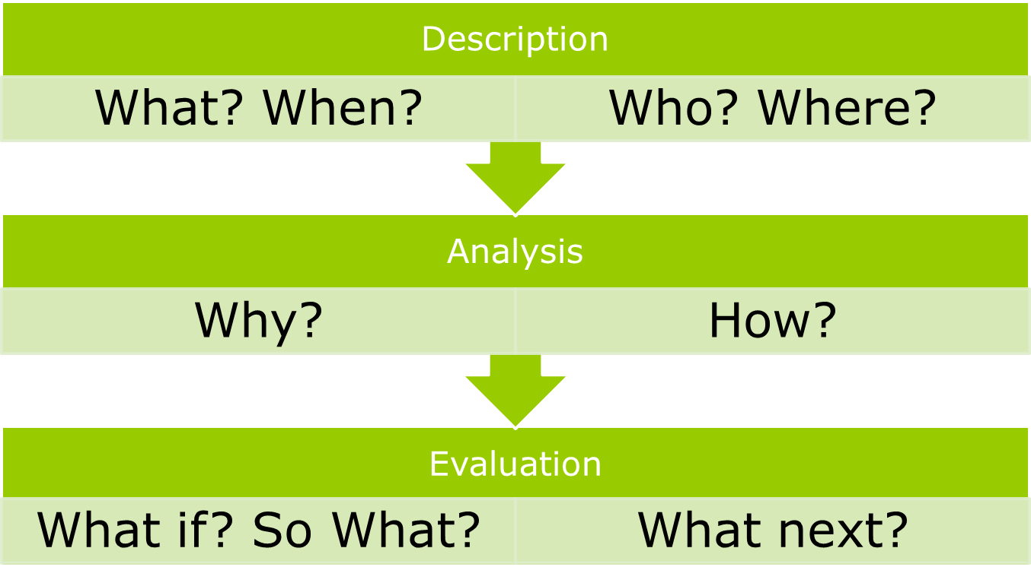
Moving from description to analysis

Slide 13
Critical Thinking – Six steps
Knowledge
Comprehension
Application
Analysis
Synthesis
Evaluation

Slide 14
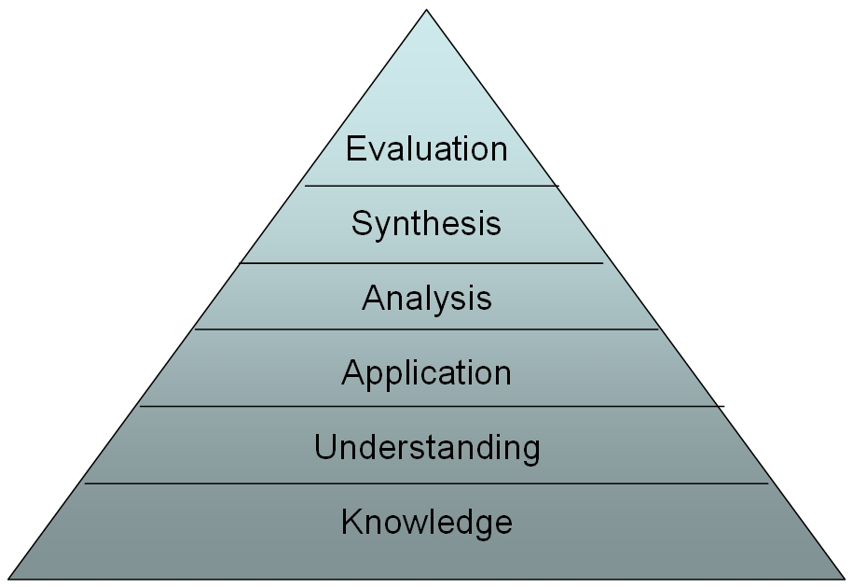
Bloom’s taxonomy
Notes:
Three domains cognitive (knowledge, development of intellectual skills), affective (emotional/attitudes, personal growth), psychomotor (manual, physical skills)
Think of 3 key words for each level which would demonstrate requirement at that level eg knowledge, understanding, application

Slide 15
Analysis & Evaluation
Analysis is the process of breaking a complex topic or substance into smaller parts to gain a better understanding of it.
Evaluation is systematic determination of merit, worth, and significance of something or someone using criteria against a set of standards.
Synthesis combining a number of different components to come up with a new idea or theory

Slide 16
Critical analysis
Instead of describing, offer objective explanations, evidence and evaluation of why certain things are said or done.
Try and relate theory to what happens in practice – case study examples
Critical analysis doesn’t happen over night – you need to work on it and read!!!

Slide 17
Things to think about
Scepticism and trust
  Polite doubt
  What you know at a given time may only be part of the picture
  Attention to detail /repetition in reading and checking nothing has been missed
Taking different perspectives
Objectivity – putting your own likes/beliefs and interests to one side with the aim of gaining the most accurate information/deeper understanding

Slide 18
Rate yourself…
Complete the self evaluation
Make an action plan for how you are now going to develop your critical thinking skills

Slide 19
Why think critically?
Why is this going to benefit you?
  Attention and observation
  More focused reading
  Improved ability to identify key points
  Improved ability to respond to key points
  Knowledge of how to get you own point across
  Skills in analysis.

Slide 20
Self awareness
Reflecting on and evaluating personal motivations, interests, prejudices, expertise and gaps in own knowledge.
Questioning own point of view; checking evidence used to support it.
Challenging and takes courage – we don’t like to think we don’t know ourselves well; we don’t like to put ourselves out on a limb, offering up opinions that might go against the grain.

Slide 21
Critical thinking as a student means:
Finding the best evidence
Evaluating (making a judgement) the evidence and supporting arguments
Coming to an opinion about where it is leading
Describing how you came to your opinion from the evidence you had collected
Illustrate your argument

Slide 22
Barriers to critical thinking
Misunderstanding of what is meant by criticism
Over-estimating your own reasoning abilities
Lack of methods, strategies or practice
Reluctance to critique experts
Affective reasons
Mistaking information for understanding
Insufficient focus and attention to detail

Slide 23
Develop your thinking skills
Critical thinking skills are based on underlying sets of thinking skills.
  Focusing attention – recognise significance of fine details
  Using attention to fine detail in recognising patterns – similarity & difference, absence & presence, order & sequence.

Slide 24
What next?
Are jaffa cakes biscuits?

Slide 25
Summary
What is critical thinking?
What is it not?
What barriers are there to critical thinking?
How can you develop good critical thinking skills?
What are the rewards of developing effective thinking skills?
What specifically will you need to work on?

Slide 26
Session LOs
1. Identify and apply key features of critical thinking
2. Explain the relevance of critical thinking for you
3. Assess own critical thinking skills

Slide 27
References
Cottrell, S (2005) Critical thinking Skills. Develop Effective Analysis and argument. London. Palgrave Macmillan
Learning Development (2010) Critical Thinking. Plymouth University (NCD Student intranet HE Study Support)

Slide 28

Homework
Throughout the week take notice of health related news stories as we will be applying critical thinking skills to these to find out the facts behind the headlines!!

Slide 29
The process of critical thinking
Identify argument and conclusion
Evaluate the evidence
Weighing up the opposing arguments
Read between the lines
Recognise ways in which positions are made to be more appealing
Reflect on issues
Draw conclusions
Present your point of view

Slide 30
Activity
‘There has been a tremendous rise in the rate of industrial injury. This year there were over 30 reports of repetitive strain injury in the factory (Millex Injuries Report 1999) All those injured worked in the fibre department. Ten years ago there were no reported injuries. This shows that our work conditions are taking a more serious toll on our health than in the past’
Notes:
Premise – proposition believed to be true there has been a rise in industrial injuries
CONCLUSION –WORK conditions are having a more serious effect than previously. Relevent reason given –does not consider other reasons no of reported injuries may have increased ?anything known about repetitive strain injury 10 yrs ago, ?people less likely to report
No figures for other types of injury or health of workers in other depts He may be right but has not proved his case, not given sufficient reasons(evidence ) to support the conclusion

